Slide 1

React
#2 Learn Once, Write Anywhere

Slide 2

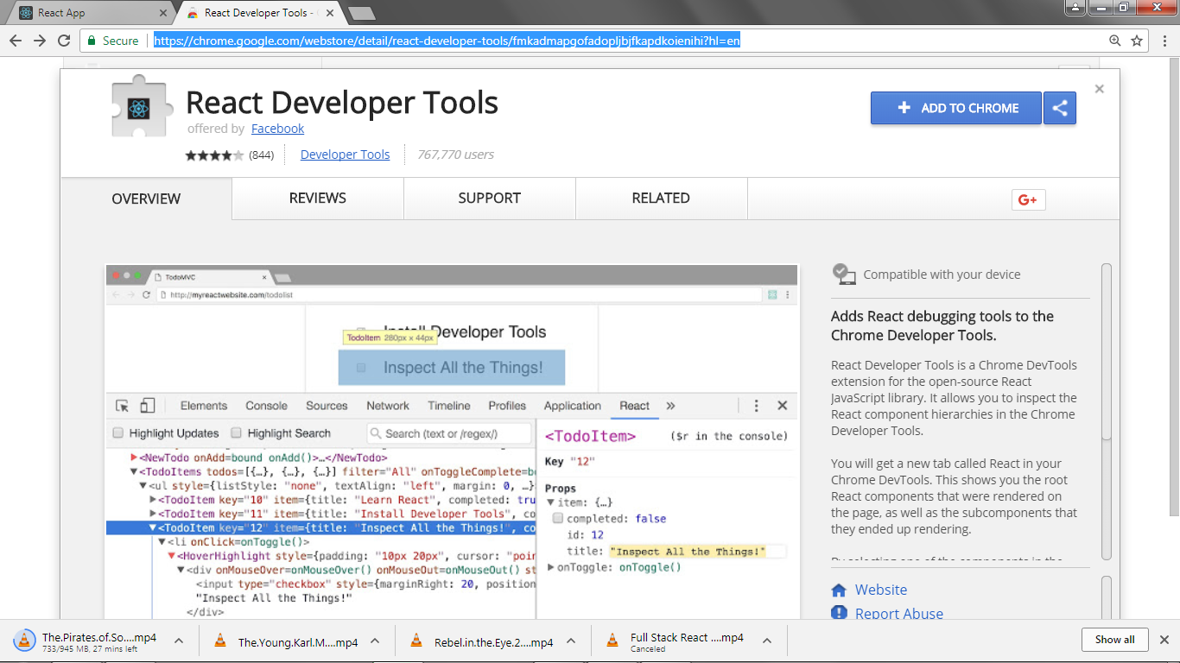
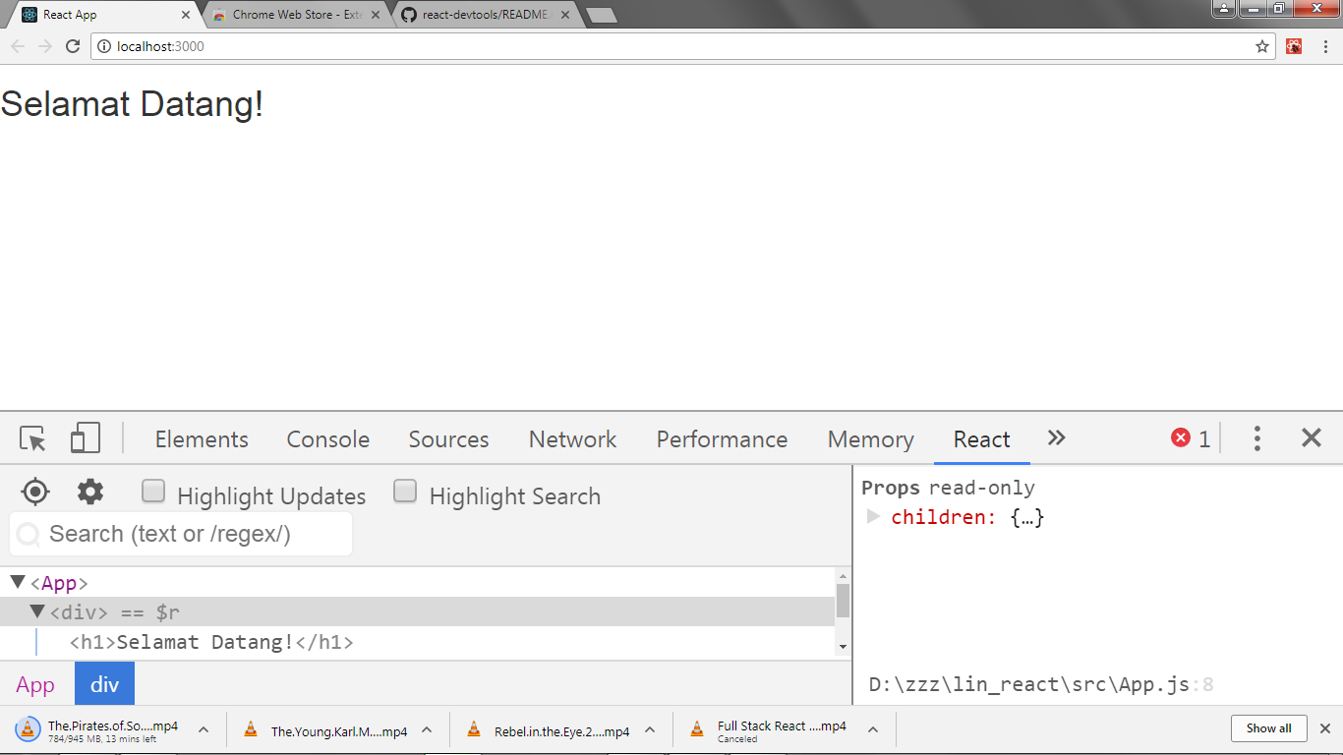
React Dev Tools
Add React Dev Tools on Chrome from: https://chrome.google.com/webstore/

Slide 3
State & Props
There are 2 types of data that control a component: State & Props.
Props are set by the parent and they’re fixed throughout the lifetime of a component. For data that is going to change, we have to use State.

Slide 4
State
In general, we should initialize state in the constructor, and then call setState when we want to change it.
State is mutable, and defines at any given time, the current state of the React component that is being rendered.

Slide 5
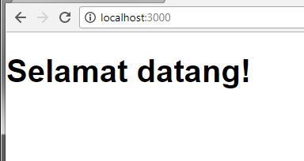
src/App.js
import React, { Component } from 'react';
class App extends Component {
render() {
return (
<h1>Selamat datang!</h1>
);
}
}
export default App;

Slide 6
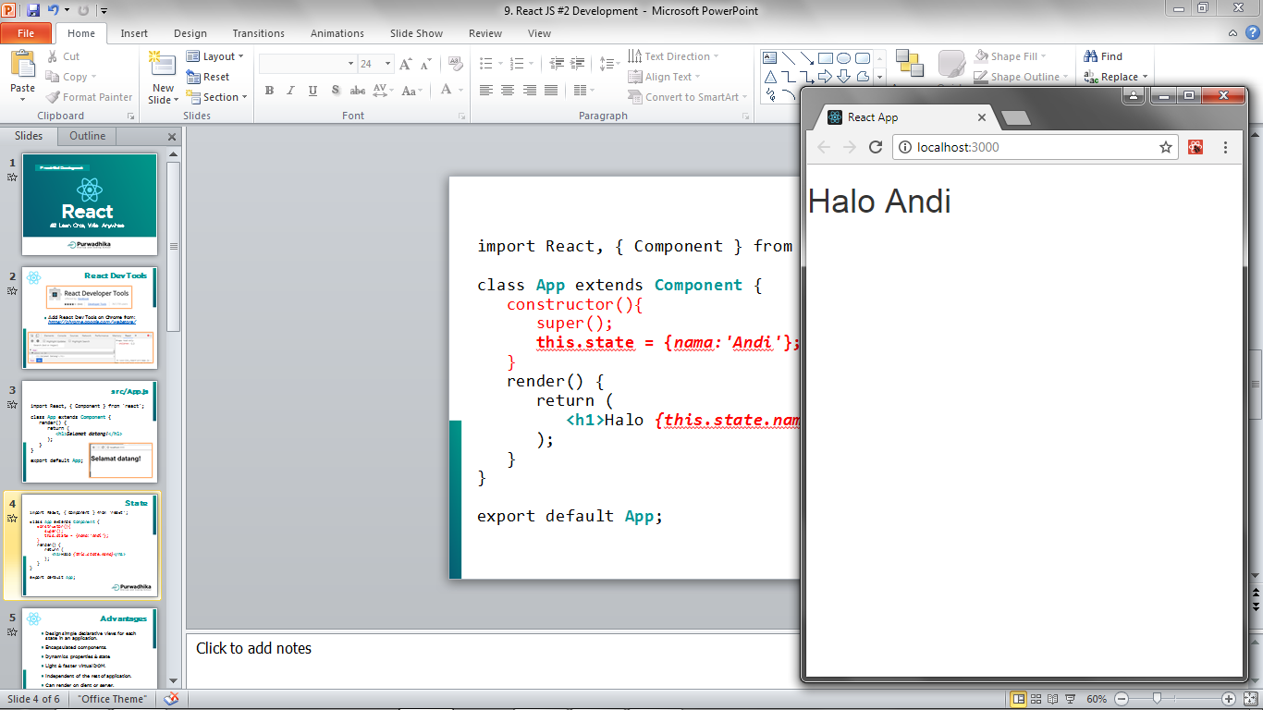
src/App.js
State #1
import React, { Component } from 'react';
class App extends Component {
constructor(){
super();
this.state = {nama:'Andi'};
}
render() {
return (
<h1>Halo {this.state.nama}</h1>
);
}
}
export default App;

Slide 7
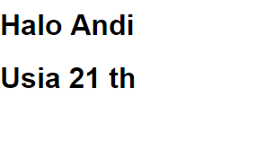
src/App.js
State #2
import React, { Component } from 'react';
class App extends Component {
constructor(){
super();
this.state = {nama:'Andi', usia:21};
}
render() {
return (
<div>
<h1>Halo {this.state.nama}</h1>
<h1>Usia {this.state.usia} th</h1>
</div>
);
}
}
export default App;

Slide 8
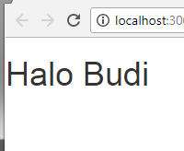
src/App.js
Updating State
import React, { Component } from 'react'; class App extends Component {
constructor(){
super();
this.state = {nama:'Andi'};
}
render() {
setTimeout(() => {
this.setState({nama: 'Budi'});
}, 3000)
return (
<h1>Halo {this.state.nama}</h1>
);
}
} export default App;

Slide 9
Props
Most components can be customized with different parameters when they are created. These creation parameters are called Props (Properties).
It lets you make a component that is used in many different places in your app, with slightly different properties in each places.
For short, props are static properties on a React component that are immutable (cannot be changed).

Slide 10
src/App.js
Props #1
import React, { Component } from 'react';
import Footer from './component/Footer';
class App extends Component {
render() {
var teks = "Hak cipta dilindungi";
return (
<div>
<h1>Selamat datang!</h1>
<Footer konten={teks} />
</div>
);
}
} export default App;

Slide 11
src/component/Footer.js
Props #1
import React, { Component } from 'react';
class Footer extends Component {
render() {
return (
<div>
<h4>{this.props.konten}</h4>
</div>
);
}
}
export default Footer;

Slide 12
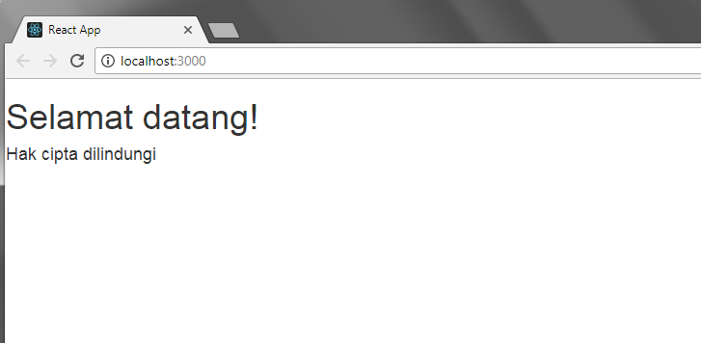
Props #1

Slide 13
src/App.js
Props #2
import React, { Component } from 'react';
import Footer from './component/Footer';
class App extends Component {
render() {
var andi = {nama:"Andi",usia:24};
return (
<div>
<h1>Selamat datang!</h1>
<Footer id={andi.nama} umur={andi.usia}/>
</div>
);
}
} export default App;

Slide 14
src/component/Footer.js
Props #2
import React, { Component } from 'react';
class Footer extends Component {
render() {
return (
<div>
<h4>Halo kakak {this.props.id}</h4>
<h4>Usia {this.props.umur} th, ya?</h4>
</div>
);
}
}
export default Footer;

Slide 15
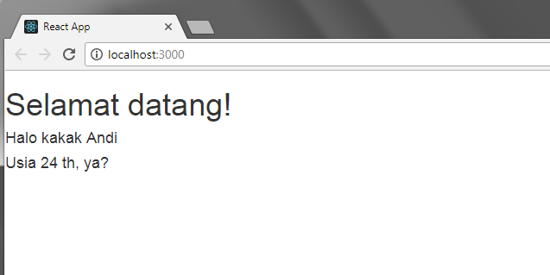
Props #2

Slide 16
src/App.js
State →Props
import React, { Component } from 'react';
import Footer from './component/Footer';
class App extends Component {
constructor(){
super();
this.state = {nama:'Andi'};
}
render() {
return (
<div>
<Footer id={this.state.nama} />
</div>
);
}
} export default App;

Slide 17
src/component/Footer.js
State →Props
import React, { Component } from 'react';
class Footer extends Component {
render() {
return (
<div>
<h1>Halo {this.props.id}</h1>
</div>
);
}
}
export default Footer;

Slide 18


Handling
Events

Slide 19
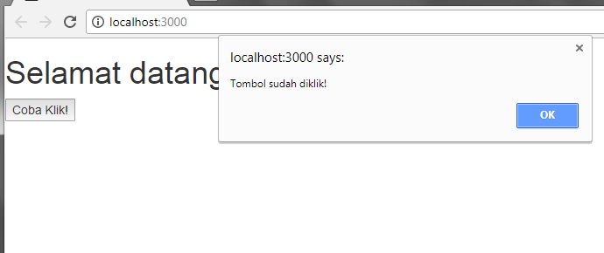
Click Event

Slide 20
src/App.js
Click Event
import React, { Component } from 'react'; class App extends Component {
klik(){
alert('Tombol sudah diklik!');
}
render() {
return (
<div>
<h1>Selamat datang!</h1>
<button onClick={this.klik}>
Coba Klik!
</button>
</div>
);
}
} export default App;

Slide 21
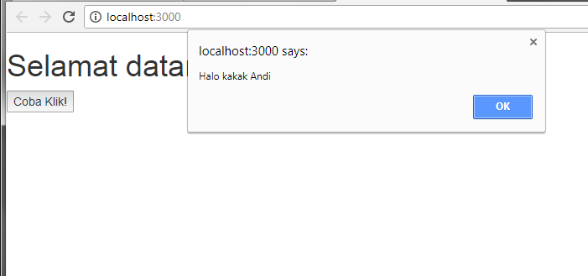
Click Event with param

Slide 22
src/App.js
Click Event with param
import React, { Component } from 'react'; class App extends Component {
klik(siapa){
alert('Halo kakak '+siapa);
}
render() {
return (
<div>
<h1>Selamat datang!</h1>
<button onClick={()=>{this.klik('Andi');}}>
Coba Klik!
</button>
</div>
);
}
} export default App;

Slide 23
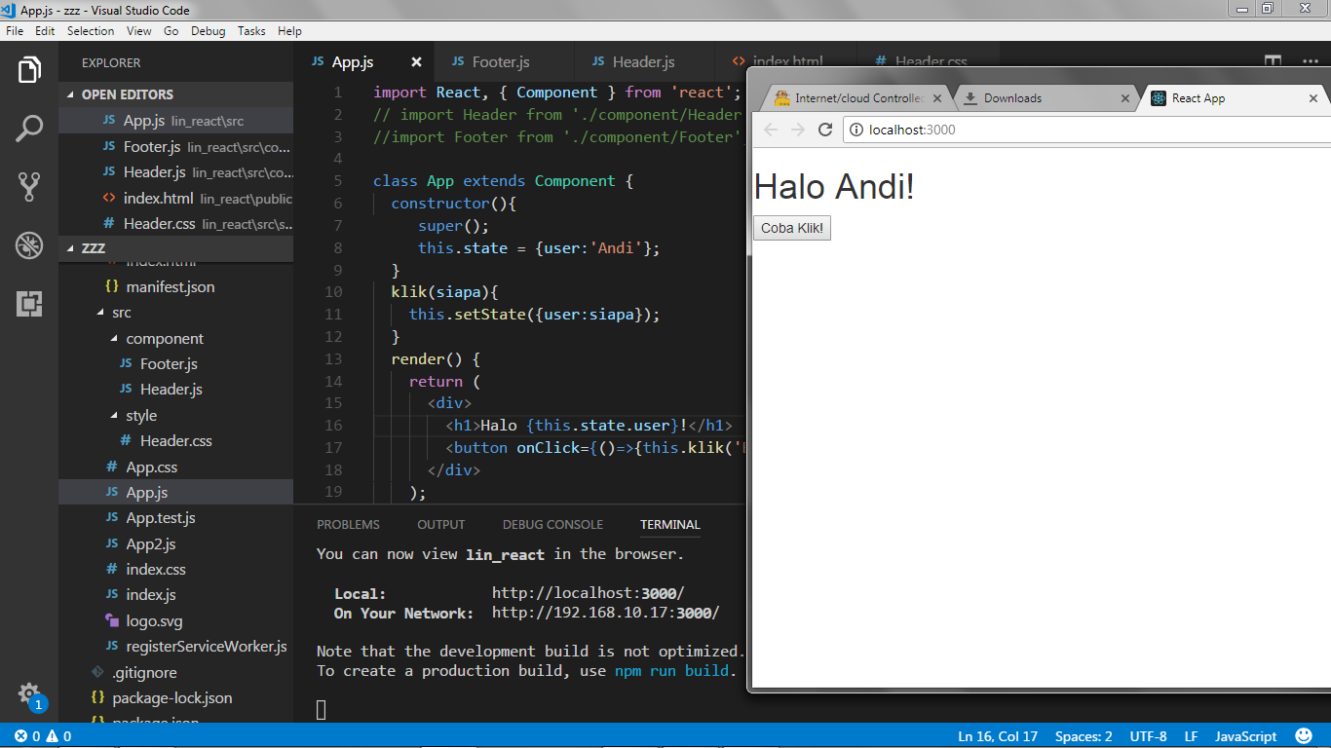
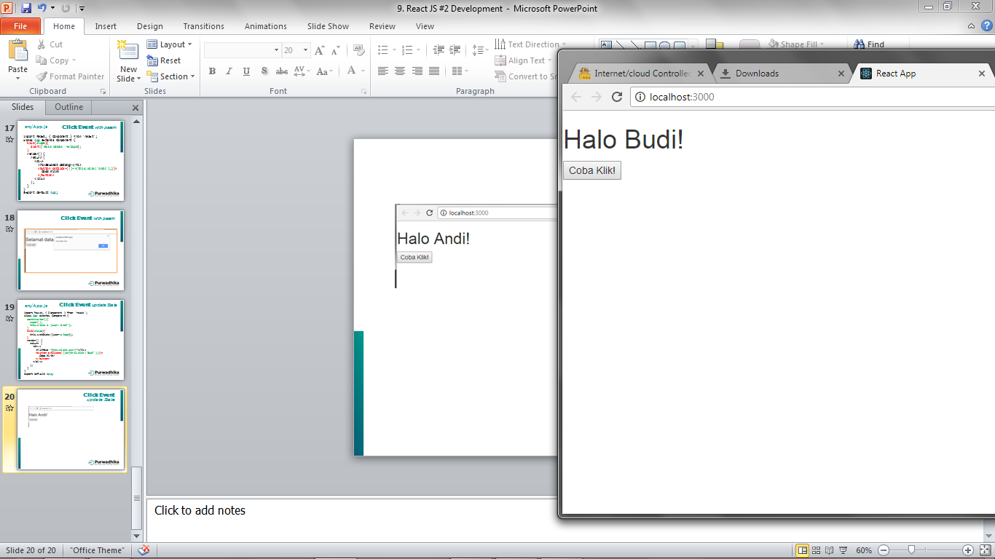
Click Event
update State #1

Slide 24
import React, { Component } from 'react'; class App extends Component {
constructor(){
super();
this.state = {user:'Andi'};
}
klik(siapa){
this.setState({user:siapa});
}
render() {
return (
<div>
<h1>Halo {this.state.user}!</h1>
<button onClick={()=>{this.klik('Budi');}}>
Coba Klik!
</button>
</div>
);
}
} export default App;
src/App.js
Click Event
update State #1

Slide 25
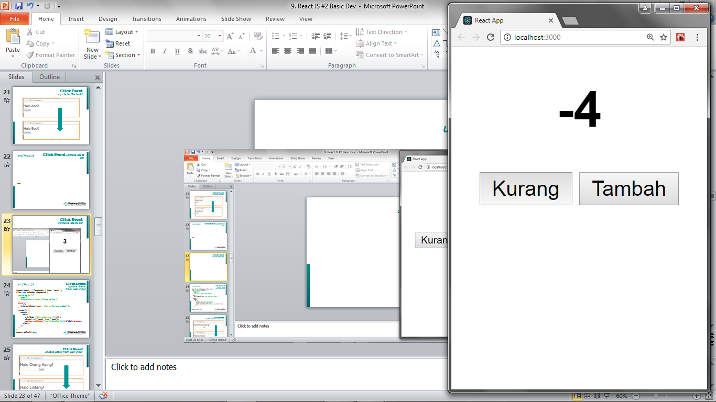
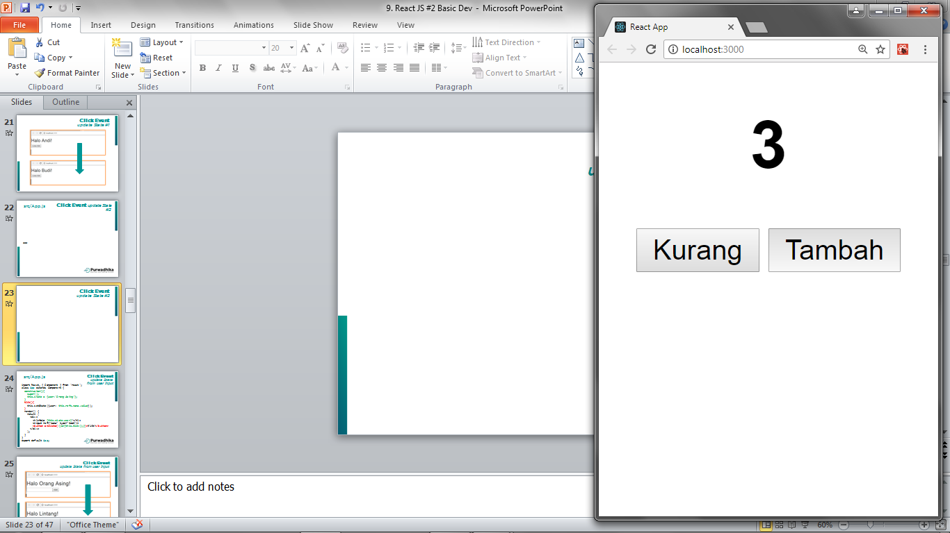
Click Event
update State #2

Slide 26
src/App.js
Click Event
update State #2
Part 1
import React, { Component } from 'react';
class App extends Component {
state = { count: 0 }
tambah = () => {
this.setState({
count: this.state.count + 1
});
}
kurang = () => {
this.setState({
count: this.state.count - 1
});
}

Slide 27
src/App.js
Click Event
update State #2
Part 2
render(){
return (
<div>
<center>
<h1>{this.state.count}</h1>
<div>
<button onClick = {this.kurang}>Kurang</button>
<span> </span>
<button onClick = {this.tambah}>Tambah</button>
</div>
</center>
</div>
);
}
}
export default App;

Slide 28
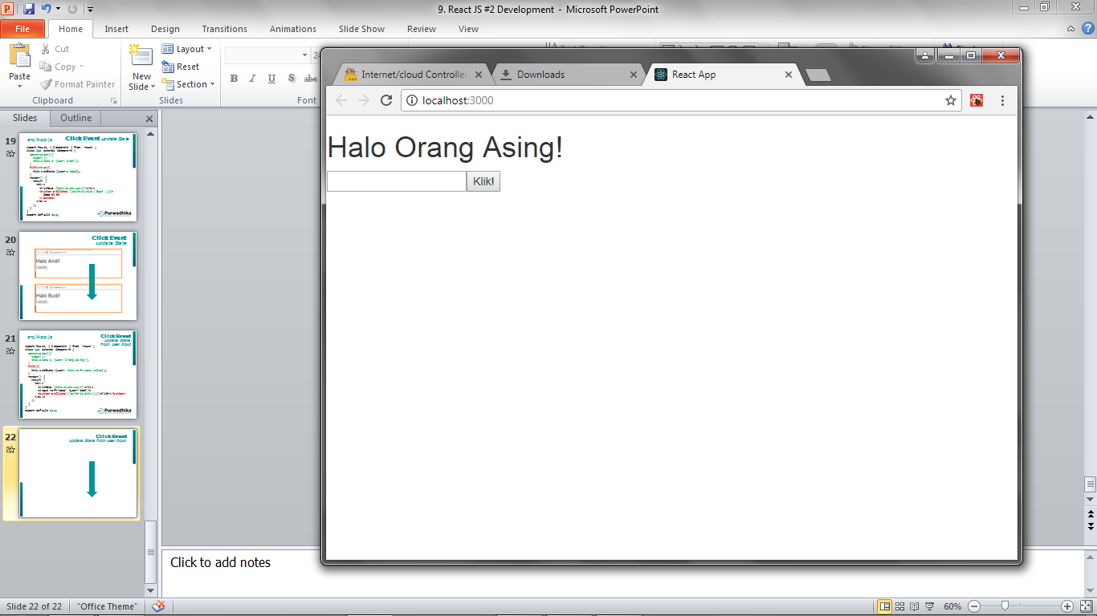
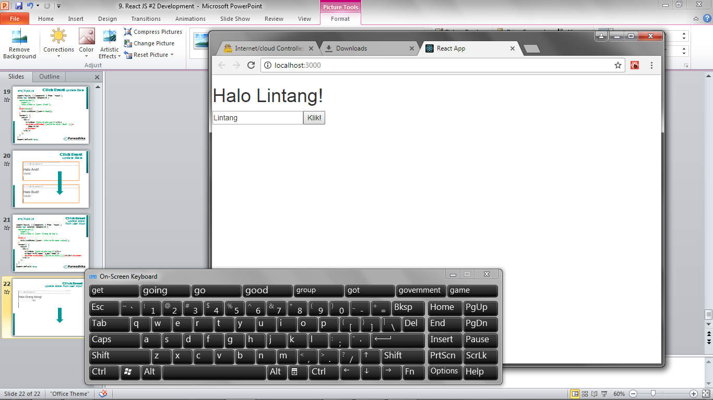
Click Event
update State from user input

Slide 29
src/App.js
Click Event
update State
from user input
import React, { Component } from 'react'; class App extends Component {
constructor(){
super();
this.state = {user:'Orang Asing'};
}
klik(){
this.setState({user: this.refs.nama.value});
}
render() {
return (
<div>
<h1>Halo {this.state.user}!</h1>
<input ref="nama" type="text"/>
<button onClick={()=>{this.klik();}}>Klik!</button>
</div>
);
}
} export default App;

Slide 30
Events
Keyboard Events
onKeyDown onKeyPress onKeyUp
Focus Events
onFocus onBlur
Form Events
onChange onInput onInvalid onSubmit
Mouse Events
onClick onContextMenu onDoubleClick onDrag
onDragEnd onDragEnter onDragExit onDragLeave
onDragOver onDragStart onDrop onMouseDown
onMouseEnter onMouseLeave onMouseMove
onMouseOut onMouseOver onMouseUp

Slide 31
Double Click Event
update State from user input

Slide 32
src/App.js
import React, { Component } from 'react'; class App extends Component {
constructor(){
super();
this.state = {user:'Orang Asing'};
}
klik(){
this.setState({user: this.refs.nama.value});
}
render() {
return (
<div>
<h1>Halo {this.state.user}!</h1>
<input ref="nama" type="text"/>
<button onDoubleClick={()=>{this.klik();}}>
Klik!
</button>
</div>
);
}
} export default App;
Double Click
update State
from user input

Slide 33
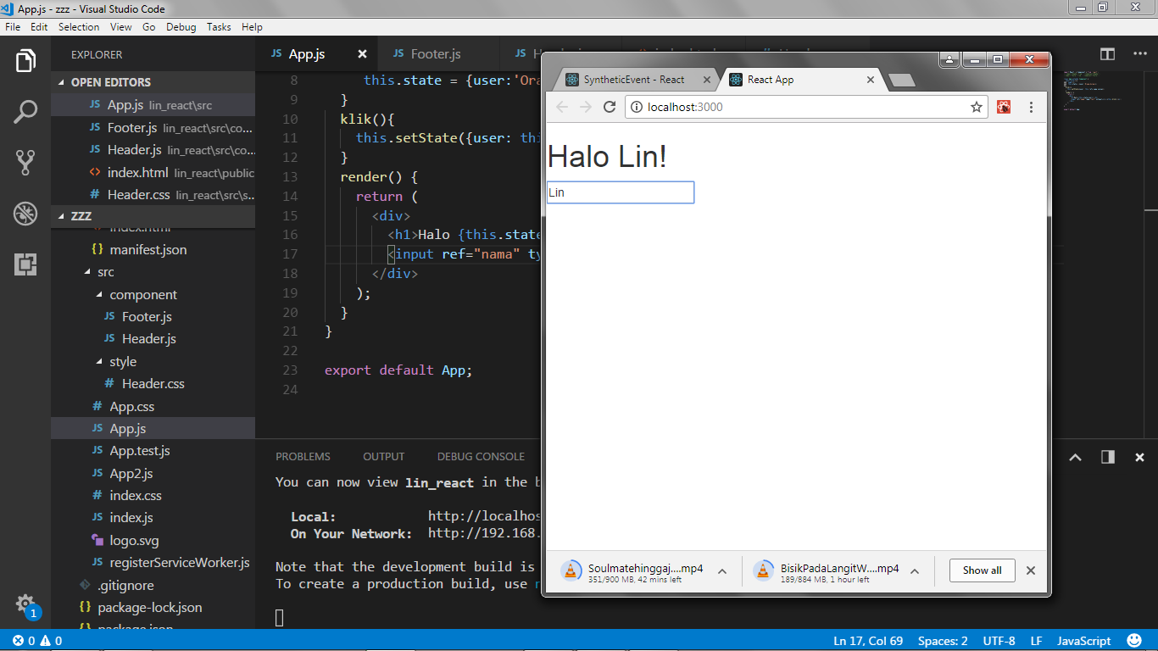
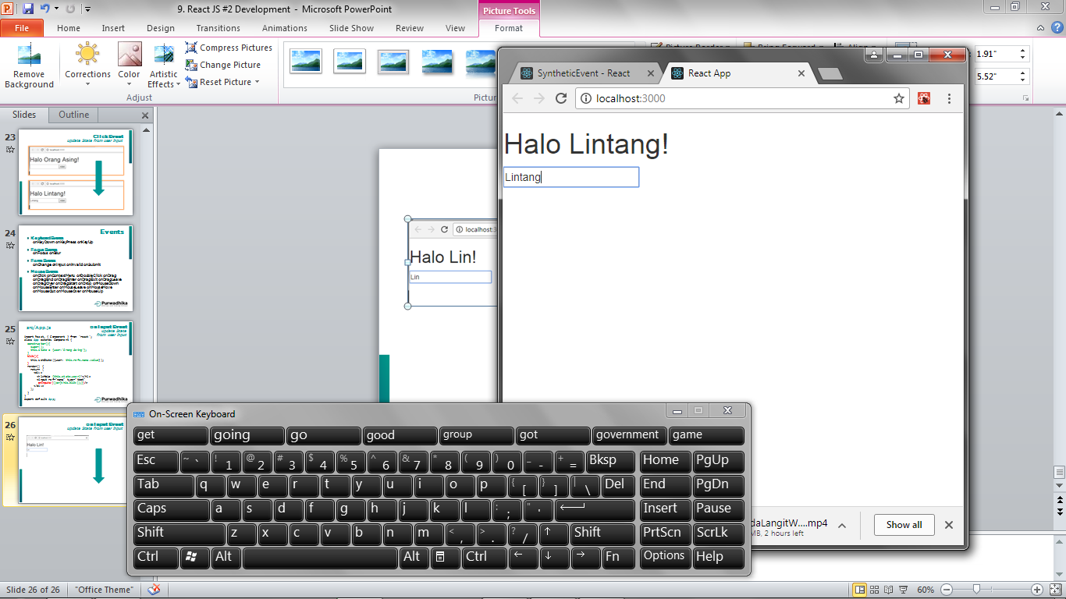
onInput Event
update State from user input

Slide 34
src/App.js
onInput Event
update State
from user input
import React, { Component } from 'react'; class App extends Component {
constructor(){
super();
this.state = {user:'Orang Asing'};
}
klik(){
this.setState({user: this.refs.nama.value});
}
render() {
return (
<div>
<h1>Halo {this.state.user}!</h1>
<input ref="nama" type="text"
onInput={()=>{this.klik();}}/>
</div>
);
}
} export default App;

Slide 35
Life-cycle Methods
#1 Mounting
componentWillMount(){}
Invoked once on both client and server, immediately before the initial rendering occurs.
componentDidMount(){}
Invoked once only on client, immediately after the initial rendering occurs.

Slide 36
Life-cycle Methods
Mounting
src/App.js
import React, { Component } from 'react'; class App extends Component {
constructor(){
super();
this.state = {user:'Orang Asing'};
}
componentWillMount(){
this.setState({user:'Yayan'});
console.log('Ini Will Mount '+this.state.user);
}
componentDidMount(){
console.log('Ini Did Mount '+this.state.user);
}
render() {
return (
<div><h1>Halo {this.state.user}!</h1></div>
);
}
} export default App;

Slide 37
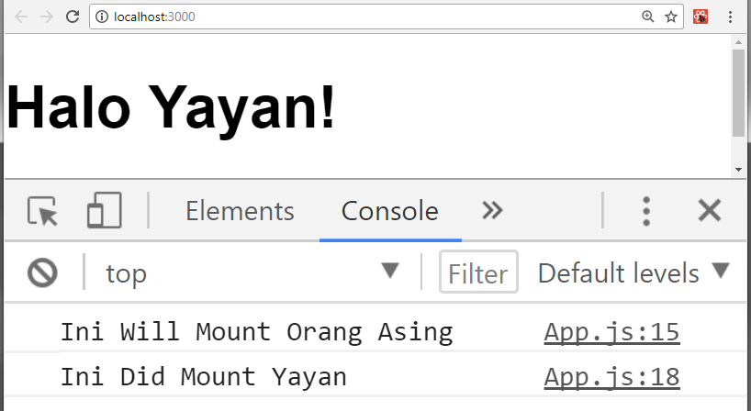
src/App.js
Life-cycle Methods
Mounting

Slide 38
Life-cycle Methods
#2 Updating
componentWillUpdate()
Invoked immediately before rendering when new props or state are being received. This isn’t called for the initial render.
componentDidUpdate()
Invoked immediately after the component’s updates are flushed to the DOM. This isn’t called for the initial render.

Slide 39
Life-cycle
Updating
import React, { Component } from 'react'; class App extends Component {
constructor(){
super();
this.state = {user:'Orang Asing'};
}
klik(){
this.setState({user: this.refs.nama.value});
}
componentWillUpdate(x, y){
console.log('Ini Will Update '+y.user);
}
componentDidUpdate(){
console.log('Ini Did Update ');
}
render() {
return (
<div><h1>Halo {this.state.user}!</h1>
<input ref="nama" type="text" onInput={()=>{this.klik();}}/>
</div>
);}} export default App;
src/App.js

Slide 40
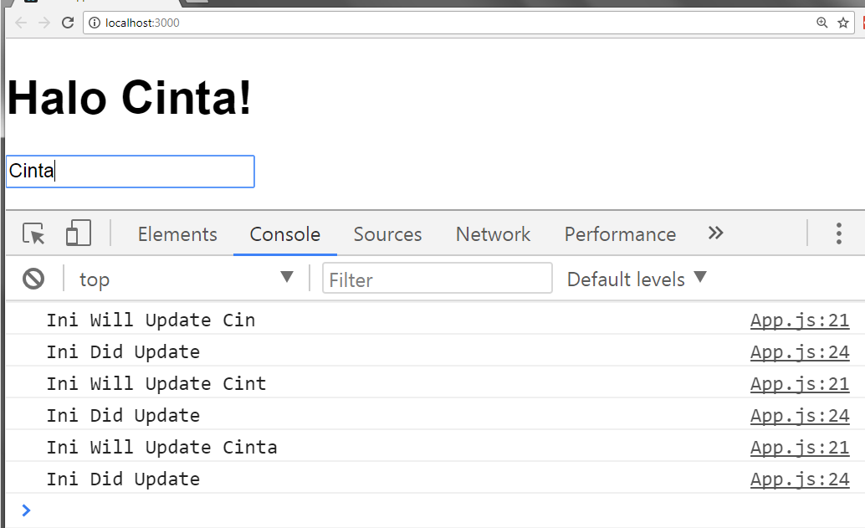
src/App.js
Life-cycle Methods
Updating

Slide 41
Router
A router allows an application to navigate between different components, changing the browser URL, modifying the browser history, and keeping the UI state in sync.
React focuses only on building user interfaces, so it doesn’t have a built-in solution for routing.
We can use React Router DOM, which allows us to define routes on our web app. First, install this package on our React project directory:
$ npm install react-router-dom --save

Slide 42
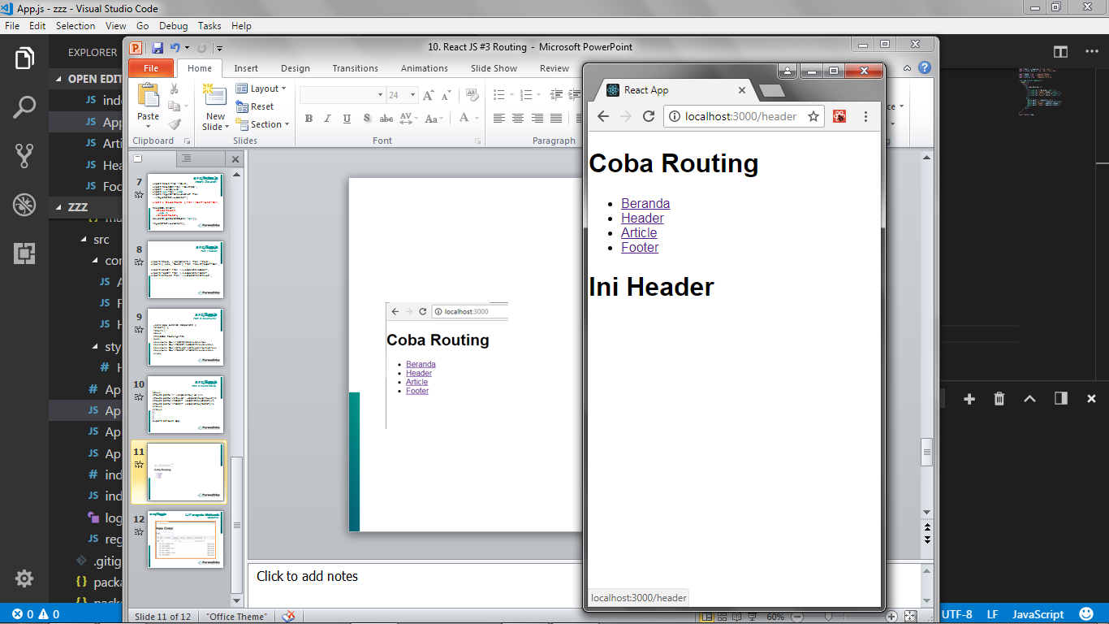
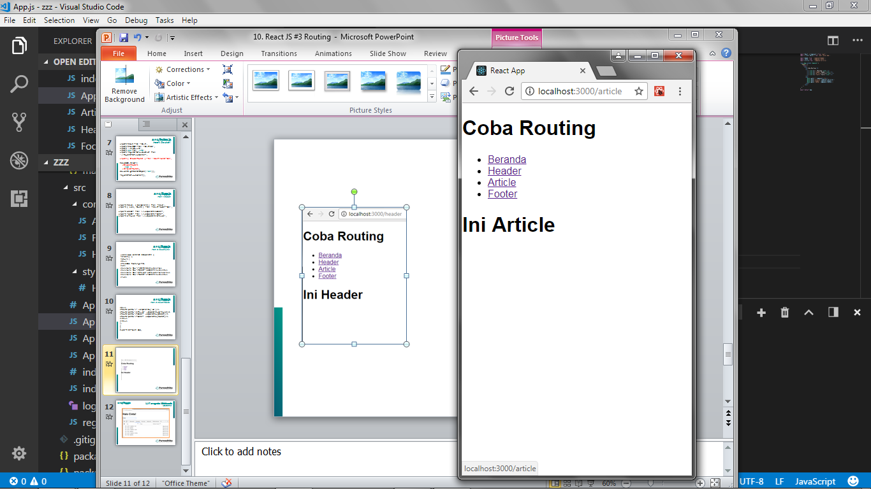
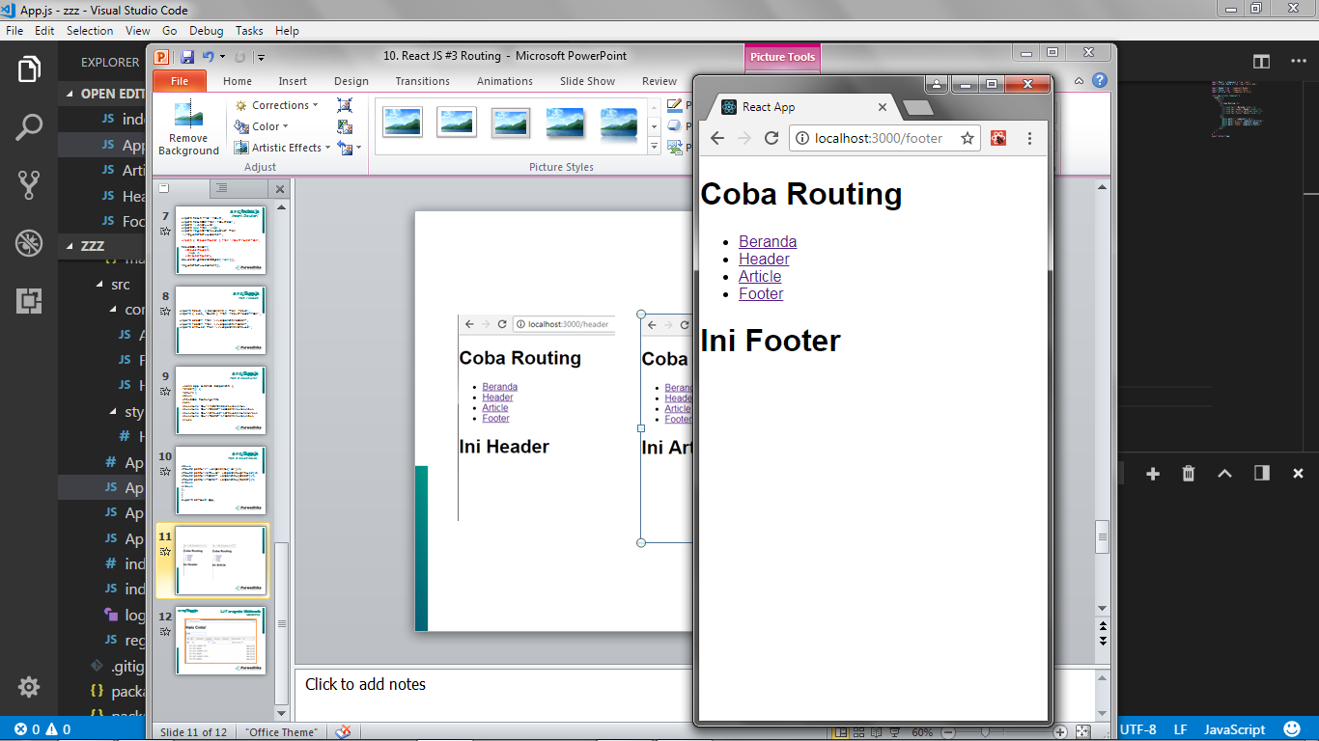
Routing
Header.js
localhost/header
Article.js
localhost/article
Footer.js
localhost/footer

Slide 43
src
component
src/App.js
Add <Link> and <Route>
Header.js
localhost/header
Article.js
localhost/article
src/index.js
Insert <App/> on <Router>
Footer.js
localhost/footer
public/
Index.html

Slide 44
src/component/Header.js
#1 component
import React, { Component } from 'react';
class Header extends Component {
render() {
return (
<h1>Ini Header!</h1>
);
}
}
export default Header;

Slide 45
src/component/Article.js
#2 component
import React, { Component } from 'react';
class Article extends Component {
render() {
return (
<h1>Ini Article!</h1>
);
}
}
export default Article;

Slide 46
src/component/Footer.js
#3 component
import React, { Component } from 'react';
class Footer extends Component {
render() {
return (
<h1>Ini Footer!</h1>
);
}
}
export default Footer;

Slide 47
src/index.js
Insert Router!
import React from 'react';
import ReactDOM from 'react-dom';
import './index.css';
import App from './App';
import registerServiceWorker from './registerServiceWorker';
import { BrowserRouter } from 'react-router-dom';
ReactDOM.render(
<BrowserRouter>
<App />
</BrowserRouter>,
document.getElementById('root'));
registerServiceWorker();

Slide 48
src/App.js
Part 1 Import
import React, { Component } from 'react';
import { Link, Route } from 'react-router-dom';
import Header from './component/Header';
import Footer from './component/Footer';
import Article from './component/Article';

Slide 49
src/App.js
Part 2 Insert Link
class App extends Component {
render() {
return (
<div>
<h1>Coba Routing</h1>
<ul>
<li><Link to="/">Beranda</Link></li>
<li><Link to="/header">Header</Link></li>
<li><Link to="/article">Article</Link></li>
<li><Link to="/footer">Footer</Link></li>
</ul>

Slide 50
src/App.js
Part 3 Insert Route
<div>
<Route exact path="/" component={'Home'}/>
<Route path="/article" component={Article}/>
<Route path="/header" component={Header}/>
<Route path="/footer" component={Footer}/>
</div>
</div>
);
}
}
export default App;

Slide 51
Routing
Header.js
localhost/header
Article.js
localhost/article
Footer.js
localhost/footer

Slide 52
React
#2 Learn Once, Write Anywhere

